Slide 1






60min
Awesome
Docker
Demos
Code-Show
Introduction
CloudTrack

Slide 2


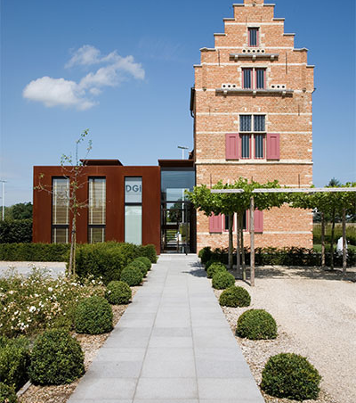

Menu
A whole bunch of free and open-source tooling you can host right now on your PC, laptop, raspberry or NAS.

Slide 3




WHY
Privacy
No 3rd Party Servers
You are in control of your data
Free & Ad-Free
Alternatives to existing products
But… manual setup & maintenance
Accessible
Typically websites
Sometimes with browser extensions etc

Slide 4




Sorry Mike
Geen Arrs vandaag!

Slide 5


The Usual Suspects
Portainer vs Rancher
⭐ 27,4k
⭐ 21,9k
Notes:
https://github.com/portainer/portainer
https://github.com/rancher/rancher

Slide 6

The Usual Suspects
Hoppscotch
⭐ 57,5k
Notes:
https://github.com/hoppscotch/hoppscotch

Slide 7

The Usual Suspects
Wordpress
⭐ 18,3k
Notes:
https://github.com/WordPress/WordPress

Slide 8



THANK YOU!

Slide 9



Menu
Thing 1

Slide 10

Menu
Thing 1

Slide 11

Menu
Thing 1

Slide 12



Menu
Thing 1

Slide 13



WiFi: itenium-guest / Wifi4Ufree
New WiFi: ITENIUM_GAST / FreeWifi

